Slide 1
Secure data hiding in images using steganography
CAPSTONE PROJECT
Presented By:-
Student Name : AYUSH SINGH
College Name & Department : GURU NANAK INSTITUTE OF TECHNOLOGY, CSE Department

Slide 2
OUTLINE
Problem Statement
Technology used:
Wow factor
End users
Result
Conclusion
Git-hub Link
Future scope

Slide 3
Problem Statement:
Secure data hiding in images using steganography:-
Why Is Secure Data Hiding Necessary?
Privacy Protection – Prevents unauthorized access to sensitive data in a world of increasing digital surveillance.
Secure Communication – Enables covert messaging for journalists, whistleblowers, and intelligence agencies.
Data Integrity & Security – Protects confidential business and government information from cyber threats.
Anti-Censorship – Allows secure sharing of information in regions with restricted internet freedom.
Prevention of Data Tampering – Ensures hidden messages remain undetectable and unchanged during transmission.

Slide 4
Technology used:
Libraries & Platforms Used:-
Libraries Used:
OpenCV (cv2) – Handles image loading, manipulation, and saving.
NumPy (numpy) – Efficient array handling and pixel manipulation.
OS (os) – Detects the operating system and opens the image accordingly.
Platforms Supported:
Windows – Uses os.system("start encryptedImage.jpg") to open images.
Linux – Uses xdg-open for opening images.
macOS – Uses open encryptedImage.jpg for compatibility.

Slide 5
Wow factors:-
Unique Features of Secure Data Hiding in Images Using Steganography:-
Double Security with Encryption
Encrypts data using AES before embedding it into an image for added protection.
Combines password-based encryption and steganography to enhance security.
Intelligent Pixel Encoding
Uses a randomized pixel pattern instead of sequential embedding to prevent easy detection.
Adapts Least Significant Bit (LSB) encoding to minimize visible distortions.
Steganalysis Resistance
Implements image noise analysis to make hidden data undetectable by AI-based forensic tools.
Ensures compression-resistant encoding to maintain secrecy even after resizing.
Mobile & Web Compatibility
Can be implemented as a mobile app or a browser-based tool for easy accessibility.
AI Integration for Optimization
AI detects hidden data vulnerabilities and suggests the best encoding strategy based on image characteristics.
This approach ensures better security, stealth, and usability, making it superior to traditional methods. 🚀

Slide 6
End users:
The end users of a Secure Data Hiding in Images Using Steganography system will include:
Cybersecurity Professionals – To securely transmit confidential data.
Journalists & Whistleblowers – To share sensitive information without detection.
Government & Defense Agencies – For secure communication in intelligence operations.
Businesses & Corporations – To protect trade secrets and internal communications.
Individuals Seeking Privacy – For personal data protection and secure messaging.
Researchers & Academics – For encryption and steganography studies.

Slide 7


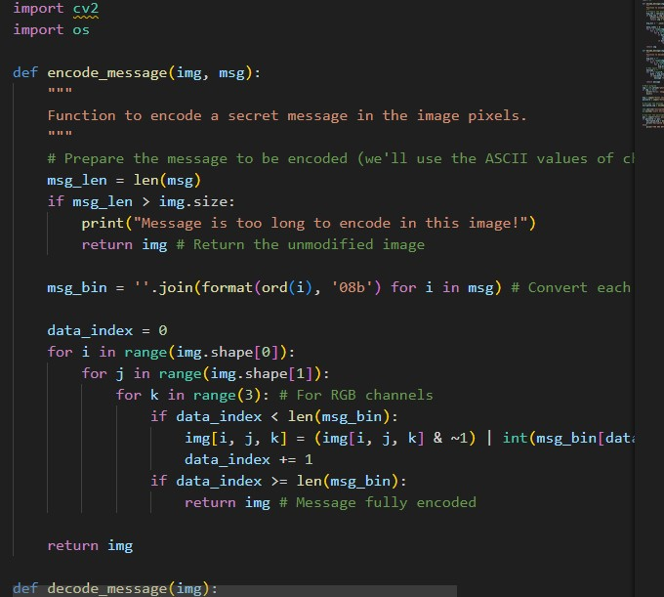
Results:-
Code ss(1):-
Encrypted Image:-
Code ss(2):-

Slide 8
Conclusion
Steganography is a powerful technique for securely hiding data within images, ensuring confidentiality and integrity. This project demonstrated how sensitive information can be embedded into digital images using various steganographic methods, making it imperceptible to unauthorized parties. By leveraging techniques such as Least Significant Bit (LSB) substitution, we successfully concealed and retrieved hidden messages without significantly affecting image quality.
Through this implementation, we addressed the problem of secure communication and data protection. Our approach enhances security in digital communication by providing an additional layer of protection against cyber threats and unauthorized access. However, while steganography is effective in concealing information, it should be combined with encryption techniques to strengthen security further.

Slide 9
GitHub Link
Git-hub Link:- https://github.com/AyushGitAI/steganography

Slide 10
Future scope:-
While this project successfully demonstrated secure data hiding using steganography, there are several areas for improvement and further research:
Enhanced Security with Encryption – Integrating encryption techniques (e.g., AES or RSA) before embedding data can add an extra layer of security, making it harder for attackers to extract meaningful information.
Robust Steganography Methods – Exploring advanced techniques like adaptive steganography, transform-domain methods (DCT, DWT), and deep learning-based steganography can improve resistance against steganalysis attacks.
Higher Capacity and Imperceptibility – Optimizing embedding algorithms to increase data hiding capacity while maintaining image quality and minimizing distortions.
Steganalysis and Attack Resistance – Implementing countermeasures against steganalysis techniques that detect hidden messages, ensuring the method remains undetectable even under scrutiny.
Cross-Platform and Real-Time Applications – Developing real-time steganographic tools for secure messaging apps, cloud storage, or IoT devices to enhance digital security in practical applications.

Slide 11
THANK YOU

